Slide 1

Molecular Phylogenetics
MSc. Vicente Machaca Arceda

Slide 2
Objectives
Understand the importance of phylogenetics trees
Implement the Neighbor joining algorithm
Use phylogenetics trees with ETE, BioPython and MEGA

Slide 3
Phylogenetics
Phylogenetics is the study of the evolutionary history of living organisms using tree like diagrams to represent pedigrees of these organisms [1].
[1] Xiong, Jin. Essential bioinformatics. Cambridge University Press, 2006.

Slide 4
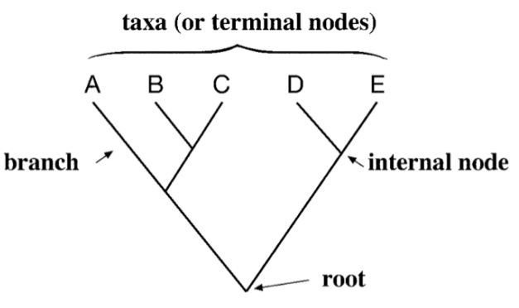
Phylogenetic tree
Figure 1.1. A typical bifurcating phylogenetic tree showing root, internal nodes, terminal nodes and branches. [1]
[1] Xiong, Jin. Essential bioinformatics. Cambridge University Press, 2006.

Slide 5
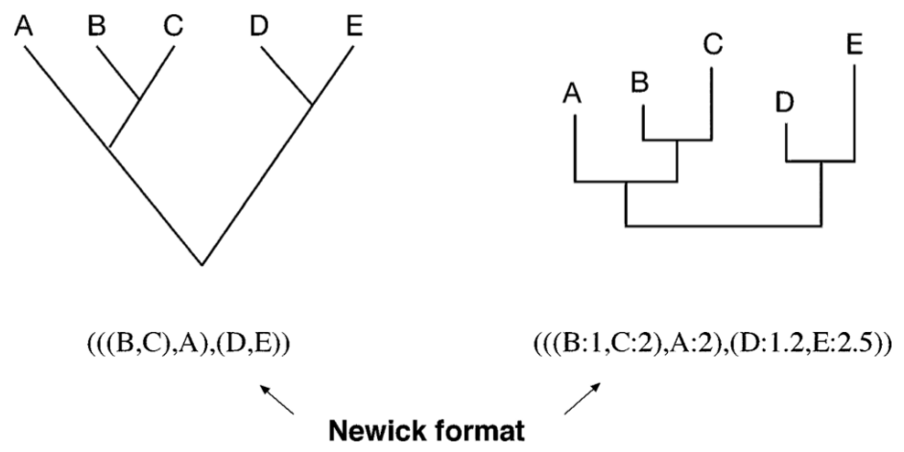
Phylogenetic tree
Figure 1.2. Newick format of tree representation. [1]
[1] Xiong, Jin. Essential bioinformatics. Cambridge University Press, 2006.

Slide 6
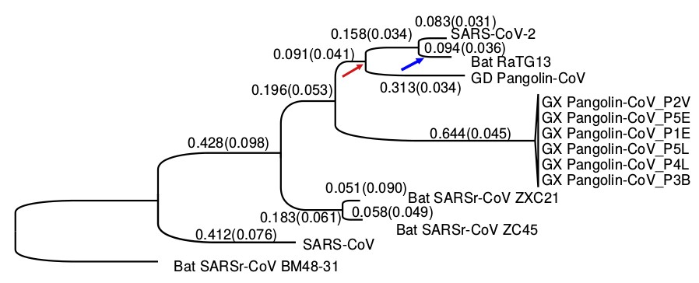
Phylogenetic tree COVID19
Figure 1.3. Molecular divergence and selective pressures during the evolution of SARS-CoV-2 (COVID19) and related viruses. [2]
[2] Tang, X., Wu, C., Li, X., Song, Y., Yao, X., Wu, X., ... & Cui, J. (2020). On the origin and continuing evolution of SARS-CoV-2. National Science Review

Slide 7
Methods
Phylogenetics methods
Distance based
Character based
Clustering based
Optimality based
Maximum Parsimony
Maximum Likelihood
UPGMA
Fitch Margoliash
Neighbor joining
Minimum Evolution
[1] Xiong, Jin. Essential bioinformatics. Cambridge University Press, 2006.

Slide 8
Phylogenetics methods
Phylogenetics methods
Distance based
Character based
Distance based
Clustering based
Optimality based
Maximum Parsimony
Clustering based
Maximum Likelihood
UPGMA
Fitch Margoliash
UPGMA
Neighbor joining
Minimum Evolution

Slide 9
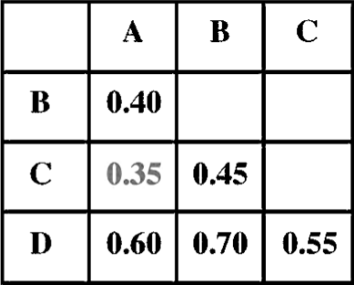
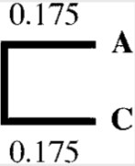
UPGMA
Matrix distances
Tree
Choose the smallest
AC/2 = 0.35/2 = 0.175

Slide 10
UPGMA
Unweighted Pair Group Method Using Arithmetic Average
Matrix distances
Tree
Choose the smallest
AC/2 = 0.35/2 = 0.175

Slide 11
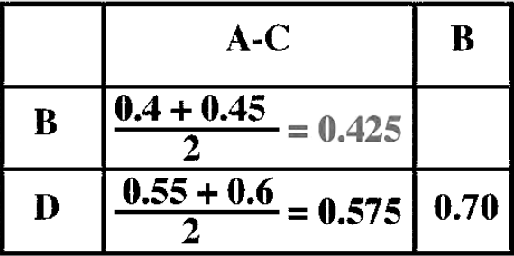
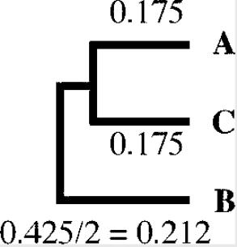
UPGMA
Unweighted Pair Group Method Using Arithmetic Average
Matrix distances
Tree
Choose the smallest

Slide 12
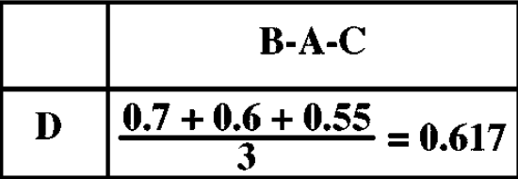
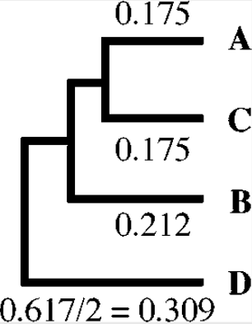
UPGMA
Unweighted Pair Group Method Using Arithmetic Average
Matrix distances
Tree
Choose the smallest

Slide 13
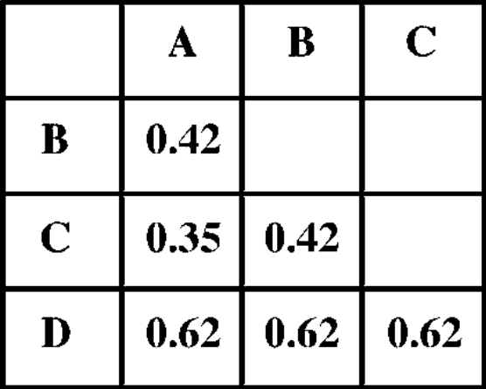
UPGMA
Unweighted Pair Group Method Using Arithmetic Average
Estimated matrix distances
Tree
0.212 + 0.212
The estimated distances don’t match the actual evolutionary distances shown, which illustrates the failure of UPGMA. However, owing to its fast speed of calculation, it has found extensive usage.
0.309 + 0.309
0.175 + 0.175

Slide 14
Homework
Implement the UPGMA algorithm
Input: Distance matrix
Output: Newick text
Redact a report with your results and conclusions

